Slide 1




Deep Learning with PyTorch
Introduction to the basics

Slide 2
1
Deep Learning fundamentals

Slide 3
1.1 What is deep learning?
Artificial Itelligence (AI) refers to a set of techniques that enable machines to imitate human behavior.
Artificial Intelligence
Machine Learning (ML) is a branch of AI dedicated to the creation of algorithms that allow systems to learn from datasets in order to perform tasks without being explicitly programmed.
Machine Learning
Deep Learning (DL) is a subset of ML that focuses on training artificial neural networks to automatically learn and adapt from large datasets, enabling them to perform advanced tasks.
Deep Learning

Slide 4



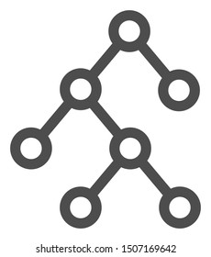
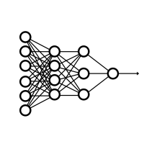
1.1 What is deep learning?
Traditional
programming
Input
Program/Rules
Output
Machine Learning
Input
Feature extraction
Classification algorithm
Output
What we’re going to cover
Deep Learning
Input
Feature extraction + classification
Output

Slide 5

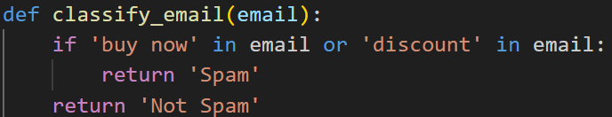

1.1 What is deep learning?: Example Spam email detection
Traditional
programming
SPAM
email
NO SPAM
Code written by a programmer to classify an email
Specific words:
“limited time offer”, “urgent”, “guarantee”
Metadata: Domain, timestamp
SPAM
Machine Learning
Text stadistics: Nº of paragraphs, average word length…
NO SPAM
email
Features manually extracted from email
Classification algorithm
Deep Learning
SPAM
email
NO SPAM
Deep neural network: Extracts features automatically from the email and classifies it

Slide 6
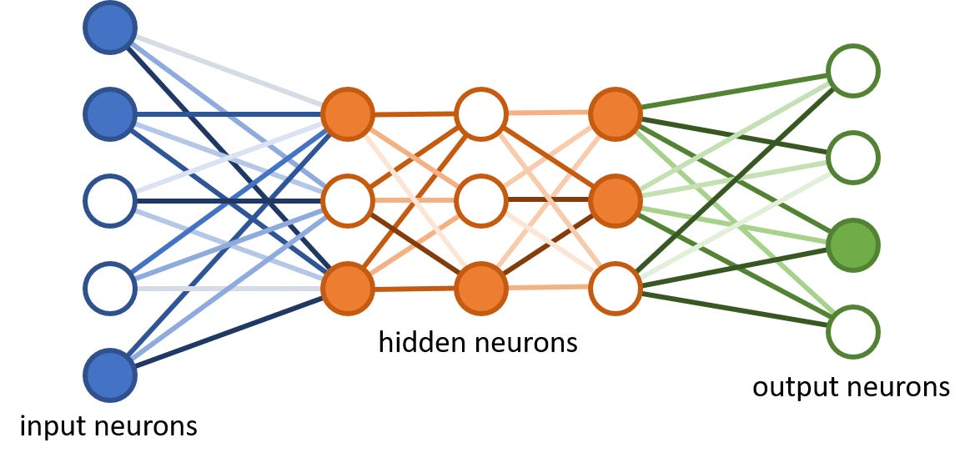
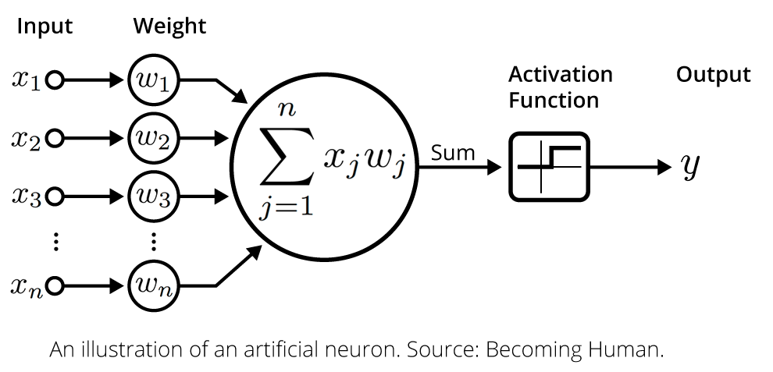
1.2 Artificial neural networks
Overall architecture of a neural network:
Hidden layer(s):
Learns patterns (features) in data
Input layer:
Receives the data
Output layer:
Provides the results
Each neuron is usually a combination of linear and/or non-linear functions

Slide 7

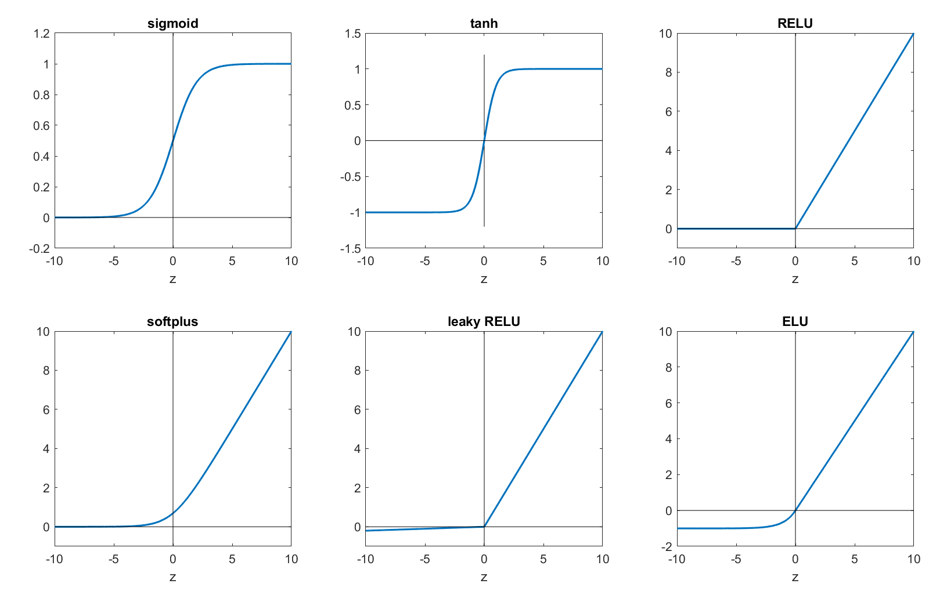
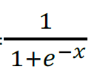
1.2 Artificial neural networks
*We will discuss the different classification problems in more detail later
Common activation functions
In classification tasks, the output layer can utilize the following functions to convert model predictions into probabilities:
Softmax: Applied in multi-class* classification to obtain probabilities for each class that add up to 1.
Sigmoid: Employed in binary* or multi-label* classification to obtain individual probabilities for each class.
Predictions (output layer)
Softmax activation function
Class
Probabilities
Cat
sigmoid
tanh
RELU
Most used
in hidden layers
Dog
Horse
Bird
Fish
softplus
leaky RELU
ELU
Prediction (output layer)
Sigmoid function
Class
Probability
Cancer
diagnosis
0.89
2.1

Slide 8





1.3 Deep learning frameworks
A deep learning framework is a software library that simplifies the process of designing, training, and validating deep neural networks. It provides a high-level interface and a comprehensive set of tools, algorithms, and pre-defined layers to facilitate the development of complex architectures.
That way, researchers and practitioners can focus on model design, experimentation, and optimization, making the development of deep learning models more accessible and efficient.
Popular deep learning frameworks include:
In this bootcamp

Slide 9
2
Introduction to PyTorch

Slide 10
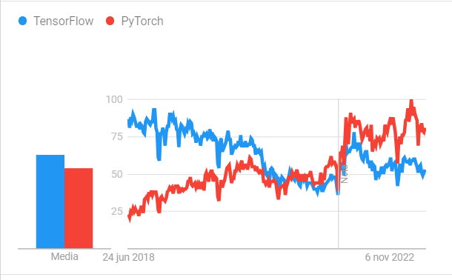

2.1 Features
Originally designed and used in-house by Facebook/Meta (now open source and used by companies such as Tesla, Microsoft, OpenAI).
PyTorch stands out for its ability to work with large datasets at a fast speed (high-performance).
With PyTorch, you can seamlessly implement the end-to-end workflow of data preprocessing, model development, hyperparameter tuning, training, evaluation, deployment and integration into your application or cloud infrastructure.
Able to access many pre-built deep learning models (Torch Hub/ torchvision.models).
PyTorch's integration with NVIDIA CUDA allows users to leverage GPUs for accelerated deep learning tasks:
GPUs (Graphics Processing Units) are powerful hardware components known for their parallel processing capabilities.
GPU acceleration in PyTorch enables faster training, efficient inference, scalability, and drives deep learning advancements.
Comparing the Time-Based Interest in TensorFlow vs PyTorch (June 2018 - June 2023) using Google Trends

Slide 11
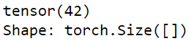
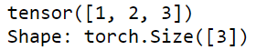
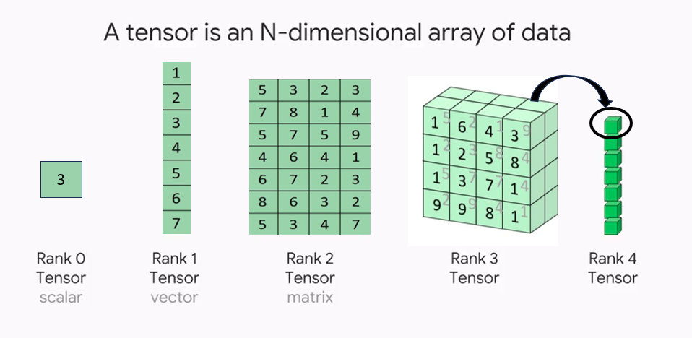
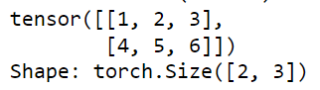
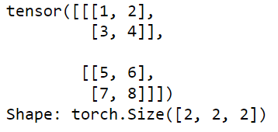
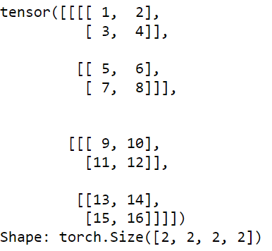
2.2 Data structure in PyTorch: Tensors
Tensors are fundamental data structures in PyTorch used for multi-dimensional array computations.
They are similar to NumPy arrays, but with additional GPU acceleration capabilities.
Examples of N-dimensional tensors
0-dim (scalar)
1-dim (vector)
2-dim (matrix)
3-dim
4-dim
…

Slide 12
2.2 Data structure in PyTorch: Tensors
Tensor properties include:
Property | Meaning | Code | Results for the tensor:
Shape | The length (number of elements) of each of the dimensions of a tensor. | tensor.shape tensor.size() | torch.Size([2, 3])
Rank | The total number of tensor dimensions. A scalar has rank 0, a vector has rank 1… | tensor.ndim | 2
Data Type | Tensors can have different data types, such as float, integer, or boolean, which determine the type of values they can hold. | tensor.dtype | torch.int64
Device | It indicates whether the tensor is stored in CPU or GPU memory | tensor.device | device(type='cpu')
Requires Grad | It specifies whether the tensor requires gradient calculations for automatic differentiation and backpropagation during training | tensor.requires_grad | False
tensor = torch.tensor([[1, 2, 3], [4, 5, 6]])

Slide 13
2.2 Data structure in PyTorch: Tensors
Creating Tensors
torch.tensor(data,*): The basic function to create a tensor from existing data.
torch.zeros(size,*) and torch.ones(size,*): Functions to create tensors filled with zeros or ones.
torch.randn(size, *): Generates tensors with values drawn from a normal distribution.
* You can include optional arguments to specify, e.g., data type, device or gradient tracking.
Common Operations
Element-Wise Operations: Perform operations like addition, subtraction, multiplication, and division on corresponding elements of tensors.
Reshaping: Change the shape of a tensor using functions like view(), reshape(), or squeeze().
Reduction: Compute summary statistics, such as sum, mean, or maximum, across tensor dimensions.
GPU Acceleration with Tensors
torch.tensor(data, device = “cuda”): Tensor initialization on GPU
tensor.to(device): Transfer tensors between CPU and GPU device.
Example: tensor.to(“cpu”) or tensor.cpu(): Moving tensors back to CPU

Slide 14



2.3 Code examples
Let’s code!
Find examples and exercises to practice with tensors in the following directories:
notebooks
00_tensor_basics.ipynb
exercise_solutions
00_tensor_basics_solutions.ipynb
If you need additional information about PyTorch tensors, check out this link

Slide 15
3
Convolutional Neural Networks (CNN)

Slide 16




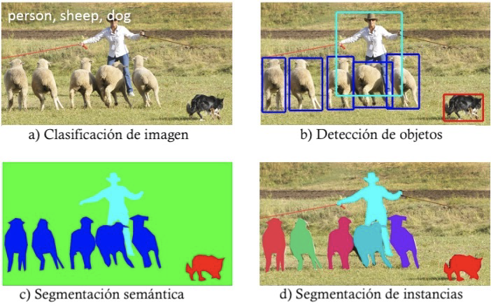
3.1 Computer vision
Covered in this bootcamp
Deep learning can be applied to various types of data. In this bootcamp, we will specifically explore deep learning techniques for image analysis. That way, we will delve into the field of computer vision, which consists of simulating the processes carried out by the human visual system.
Text
Images
Audio
Tabular data
Common computer vision tasks include:
Input image
Classification | Detection | Segmentation
Identification of the classes present in the image | Location of each instance, which is usually represented by drawing a bounding box around it | It requires classification at the pixel level. Different values are assigned to the pixels belonging to each category
Output of each model
Person
Sheep
Dog

Slide 17
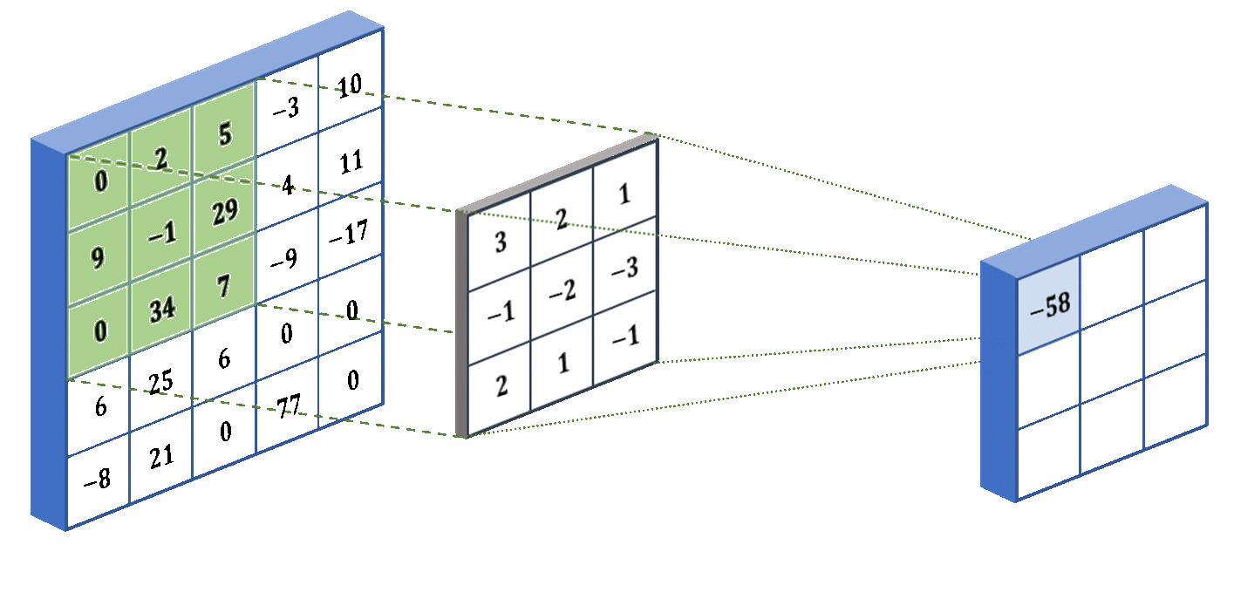
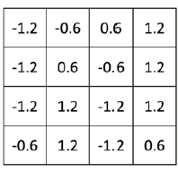

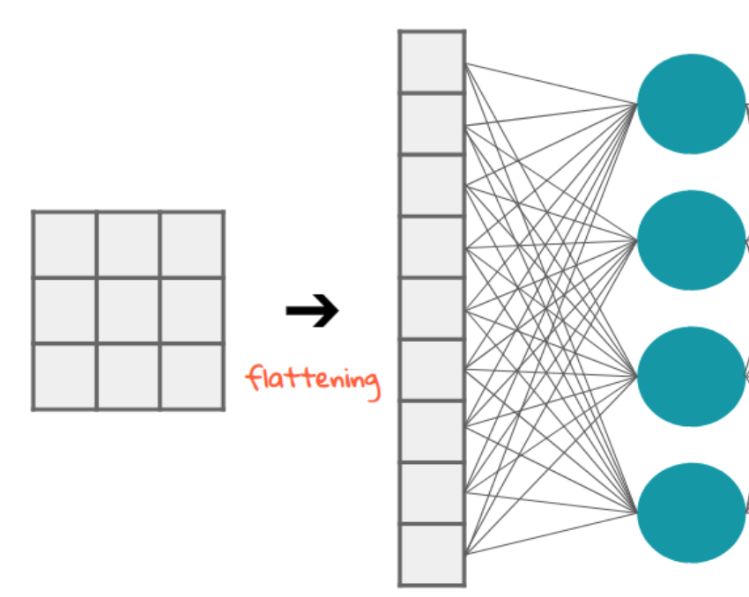
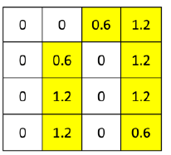
3.2 CNN architecture
Convolutional neural networks (CNNs) are a specialized type of neural network designed for image processing tasks. A typical CNN architecture (for classification tasks) can be divided into the following layers:
Layer Type | Convolutional layer | Non-linear activation | Pooling layers | Fully connected (FC) layer
What does it do? | Extracts/learns the most important features from images, creating the “feature maps” | Add a non-linearity to learned features. Among these activation functions, ReLu is widely used, which sets any negative values to 0 | Placed after a convolution layer to reduce the spatial resolution of their outputs | In the last convolutional layer, the flattening method is applied, which transforms a matrix into a vector. Then, the FC layer generates the output predictions
Code | torch.nn.Conv2d() | torch.nn.ReLu() | torch.nn.MaxPool2d() torch.nn.AvgPool2d() | torch.nn.Flatten() torch.nn.linear()
Visual representation
Feature map
ReLu
MaxPool: keeps the maximum value in each window
Image
Kernel/Filter

Slide 18

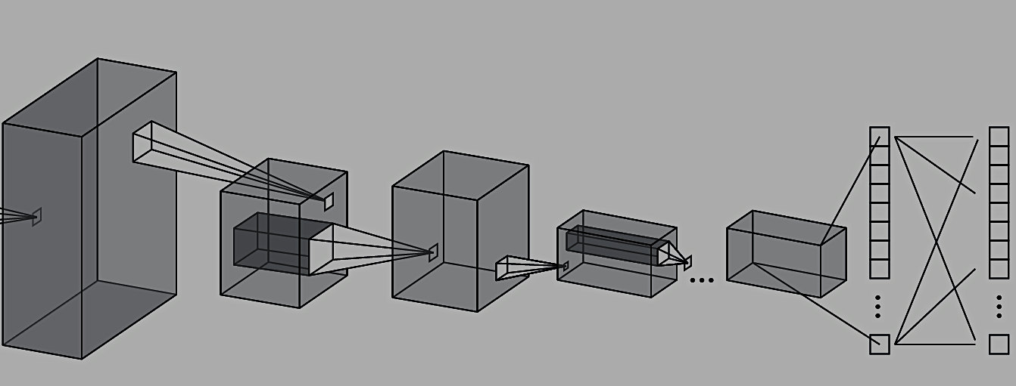
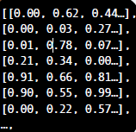
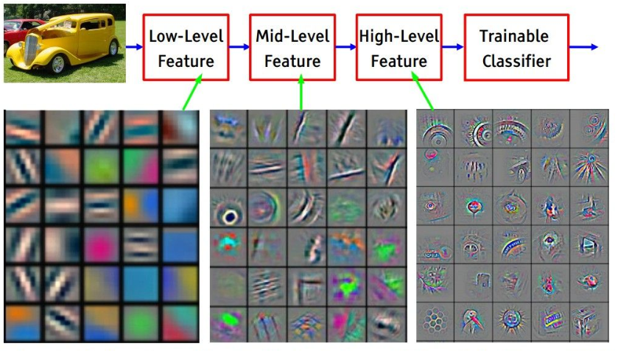
3.2 CNN architecture: Classification example
CNN: Classification network
Cat: 5%
Dog: 91%
Horse: 3%
Bird: 1%
Fish: 0%
Input image
Image transformed into a tensor
Fully connected layers utilize the feature maps generated in the previous stage to classify the images into specific categories
Convolutional layer +
ReLu +
Pooling layer
Feature maps (or activation maps) that detect patters, colours, edges… in the images

Slide 19
3.3 Inference with pretrained models available in PyTorch
Let’s code!
Working with popular computer vision architectures:
PyTorch offers a wide range of computer vision models for various image-related tasks. These models encompass a wide range of architectures, including popular ones like ResNet, VGG, DenseNet… These pre-trained models can be easily loaded and used for tasks such as image classification, object detection, semantic segmentation… In the following notebooks, we will learn how to access and use these architectures.
notebooks
01_models_inference.ipynb
exercise_solutions
01_ models_inference _solutions.ipynb

